Slide 1

SMT. KASHIBAI NAVALE COLLEGE OF ENGINEERING
Seminar on
Intelligent System For Helmet Detection Using Raspberry Pi
By -
Athuljith MK (B6202)
Sourabh Pardeshi (B6211)
Biren Patel (B6215)
Vivien Rajguru (B6218)
Guided by
Prof. N.S. More

Slide 2
CONTENTS :
__________________________________________________________________________
Introduction
Literature Survey
Problem Statement with clear title
System Architecture
Technologies Used (HW and SW requirements)
UML Diagrams
Conclusion
References

Slide 3
INTRODUCTION :
Two-wheelers, the mode of transport most Indians use, continue to be the most vulnerable to accidents. Indian roads were at their deadliest in 2015 claiming more than 16 lives every hour on average. Over 1.41 lakh people died in crashes, 3% more than the number of fatalities in 2014. Accidents involving two-wheelers and accounted for nearly half of the lives lost in road crashes. While 13,787 two-wheeler drivers were killed in crashes, 23,529 other people were killed in accidents involving these vehicles, while close to 1.4 lakh people were left injured in them.

Slide 4
The top five states - Uttar Pradesh, Tamil Nadu, Maharashtra, Karnataka and Rajasthan - accounted for over 40% of the fatalities. Among 53 mega cities, Delhi registered the highest number of fatalities at 2,199 and Maharashtra recorded 1,046 such deaths. Bhopal and Jaipur ranked third and fourth with the city roads claiming 1,015 and 844 lives respectively.

Slide 5
Protective smart gear to increase road safety among motorcyclists. The idea is obtained after observing that there are nearly 2500 motorcycle accidents per day in Maharashtra itself. With the use of image processing unit in Raspberry pi , the motorcycle can only be started if the rider possesses the helmet. A magnetic relay is attached to the raspberry pi circuit which detects if the standard symbol is identified or not. The standard symbol is recognized and analyzed by the pi camera. Additional feature of this gear is that an RFID tag placed inside the helmet will also act as a license.

Slide 6
Since two wheelers are the most used transport means in India , this project has a wide application in the field of transport and vehicle management. Speeding and not wearing a helmet are the two most common reasons behind motorcycle fatalities. Hence , this project will increase rider safety.

Slide 7
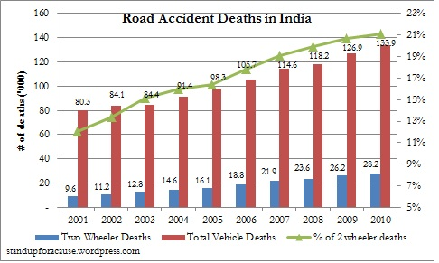
Literature Survey

Slide 8
Statistics
Table 1 : Helmet Users Increase Rate in Pune & Mumbai
Year | City | No. of users
2012 | Pune | 19.6%
 | Mumbai | 30.4%
2013 | Pune | 20.3%
 | Mumbai | 44.9%
2014 | Pune | 27.5%
 | Mumbai | 53.4%
2015 | Pune | 35.0%
 | Mumbai | 61.8%

Slide 9
Problem Statement :
To design and develop a Smart System for Helmet Detection for motorcyclists using Raspberry Pi and its modules which will ensure compulsory possession of a helmet with every motorcyclist. Scan the standard symbol using the Pi Camera module and verify if the helmet is present using image processing in Python.

Slide 10
System Architecture
Fig 1 : Actual Implementation

Slide 11
Raspberry Pi: The Raspberry Pi is a credit card-sized single-board computer. Raspberry Pi has a Broadcom BCM2835 system on chip (SoC) ,which includes an ARM1176JZFS 700 MHz processor, Video Core IV GPU ,and was originally shipped with 256 megabytes of RAM, later upgraded (Model B & Model B+) to 512 MB. Pi 2 Model B runs 6X Faster than the B+, and comes with 1GB of RAM--that's double the amount of RAM of the previous model.

Slide 12
Raspberry Pi Camera Module: The camera module utilizes the dedicated CSi interface, which is located behind the Ethernet port on the Raspberry Pi .The Raspberry Pi Camera Module has a 5MP CMOS camera with a fixed focus lens that is capable of capturing still images as well as high definition video. Stills are captured at a full HD resolution while video is supported at 1080p at 30 FPS, 720p at 60 FPS and 640x480 at 60 or 90 FPS. . This makes it ideal for projects such as hidden security cameras, high altitude balloon experiments, and even an on-board camera for RC car adventures. The camera is supported in the latest version of Raspbian , Raspberry Pi's preferred operating system.

Slide 13
Relay: A relay is an electrically operated switch. Many relays use a electromagnet to mechanically operate a switch. Relays are used where it is necessary to control a circuit by a low power signal, or where several circuits must be controlled by one signal. A type of relay that can handle the high power required to directly control an electric motor or other loads is called a contactor.

Slide 14
Standard Symbol Detection Module: When rider tries to start the bike, the pi camera will get activated and scans for standard symbol on the helmet. Then the noise is removed using different filtering and blurring techniques. Once this is done the standard symbol is detected using Edge detection technique.

Slide 15
DC Motor: A DC motor is any of a class of electrical machines that converts direct current electrical power into mechanical power. The most common types relay on the forces produced by magnetic fields. Nearly all types of DC motors have some internal mechanism, either electromechanical or electronic, to periodically change the direction of current flow in part of the motor. Most types produce rotary motion; a linear motor directly produces force and motion in a straight line.

Slide 16
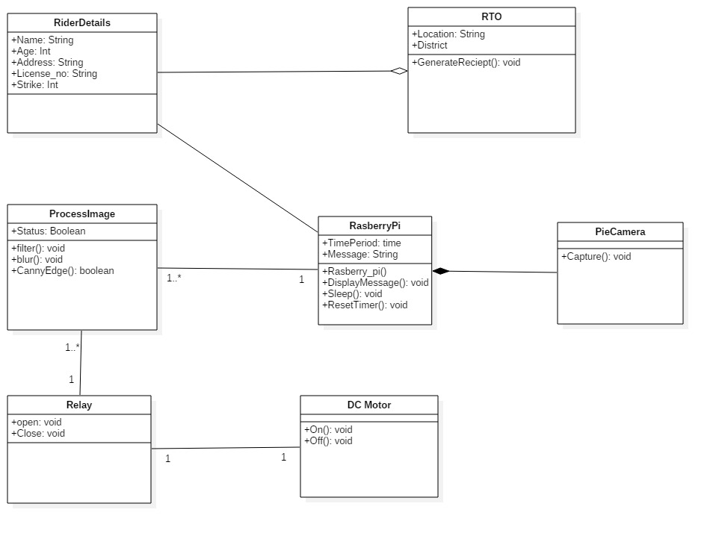
Class Diagram

Slide 17
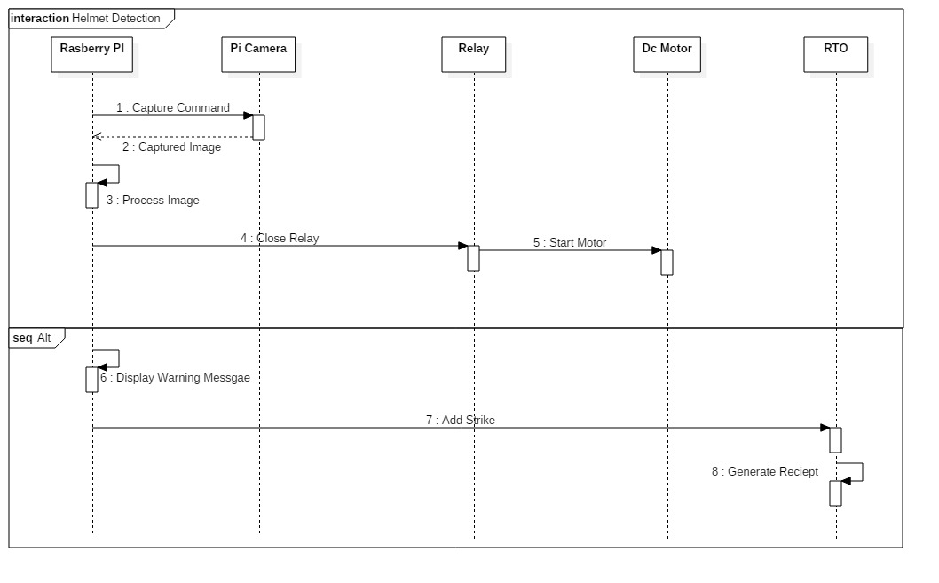
Sequence Diagram

Slide 18
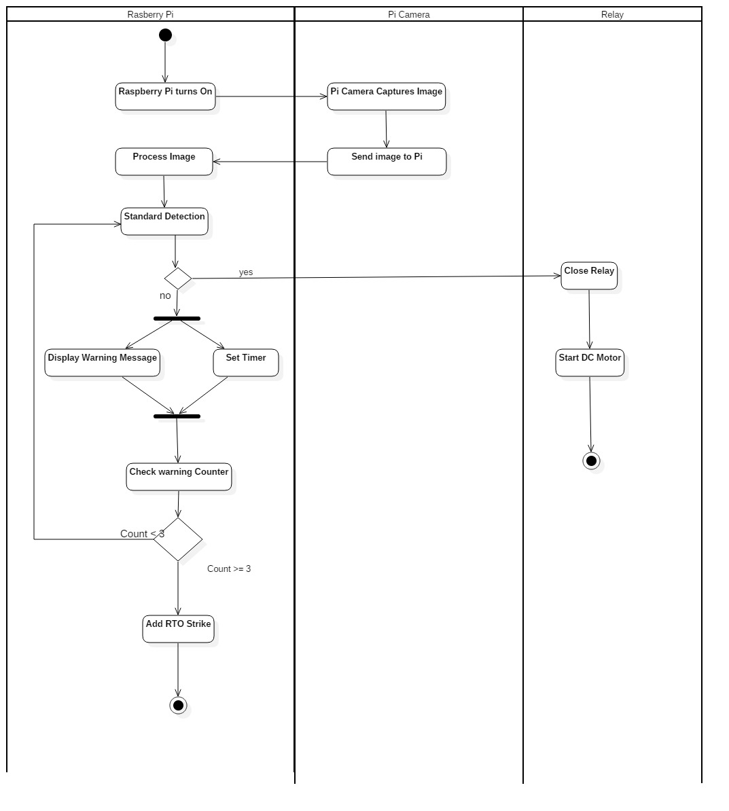
Activity Diagram

Slide 19
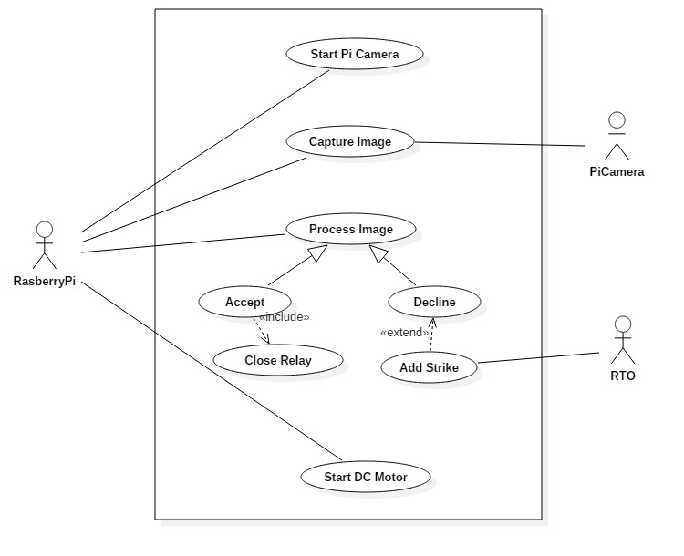
Use Case Diagram

Slide 20
Software Requirements
Python
Linux
Star UML

Slide 21
Hardware Requirements
Raspberry Pi 3 Circuit
Pi Camera
Single Channel Relay
DC Motor
12V DC Power Supply

Slide 22
APPLICATIONS:
The project is expected to improve safety and reduce accidents, especially fatal to the motorcyclist.
System with low cost and less complexity.
Reduce workload of Traffic Policemen.
The Rider will have no choice but to wear a helmet at all times during the journey.

Slide 23
CONCLUSIONS:
The scope of this project is a motorcycle rider that they care about their safety while riding. As we know, the motorcycle riders are now less concerned about their safety while riding, then the creation of this helmet safety rates can be increased and rate of road accidents can be reduced. The accident rates for motorcyclists are increasing from year to year, a Smart System for Motorcyclist using Raspberry Pi which in future will inspire safety features for motorcyclists.

Slide 24
References
[1] Romuro Silva , Kelson Aires , Thiago Santos , Kalyf Abdala “Automatic Detection of Motorcyclists Without Helmet”, Departmento de Computaco , Federal do Piaui Teresina , Brazil
[2] Manjesh N , Prof. Sudarshan Raj “Smart Helmet Using GSM & GPS Technologies for Accident Detection and Reporting” IEEE ISSN 2348-6988 (Online) Vol. 2 Issue 4.
[3] http://timesofindia.indiatimes.com/toireporter/author-Dipak-K-Dash-10519.cms

Slide 25
THANK YOU !!!

